Slide 1
PROJECT
Student Management System

Slide 2
Group members
1. Amna Maryam
2. Sana Noor

Slide 3
Project Introduction
This project is a Student Management System built using Python.
It allows users to add, view, and delete student records through a Graphical User Interface (GUI).
It is user-friendly, reduces manual work, and is ideal for school or college record management.

Slide 4
Tkinter
Built-in Python library for creating GUI.
Used: To create windows, buttons, labels, entry boxes, and listbox so that users can interact visually.
LIST
students = []
Python listWhy used: Stores all student records in memory as tuples (name, roll, course)

Slide 5
LABEL
Tk()
root = tk.
Main GUI window object
Acts as the application window where all widgets appear
tk.Label(root, text="Name")
Text displayed on the GUI
Used: Tells the user what input to enter

Slide 6
ENTRY
entry_name = tk.Entry(root)
Input field
User can type student details like name, roll number, or course
button
tk.Button(root, text="Add Student", command=add_student)
used: Performs actions (Add, View, Delete) by calling functions when clicked

Slide 7
List box
Shows all student records in the GUI and allows selection for deletion
Widget to display multiple lines of data
Message box
Shows success (info) or error messages to the user
messagebox.showinfo() or messagebox.showerror()
Functions
add_student() → Adds student details to the list
view_students() → Shows all student records in Listbox
delete_student() → Deletes selected record from the list
clear_fields() → Clears the entry boxes

Slide 8
pack()
widget.pack()
used: Arranges widgets vertically in the window so they appear properly
Without pack() → widgets will not be visible1
mainloop()
root.mainloop()
Tkinter method to run the GUI continuously

Slide 9
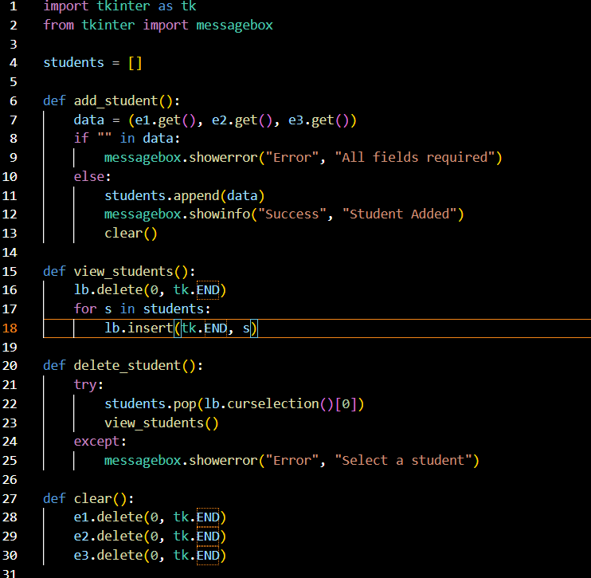

Slide 10
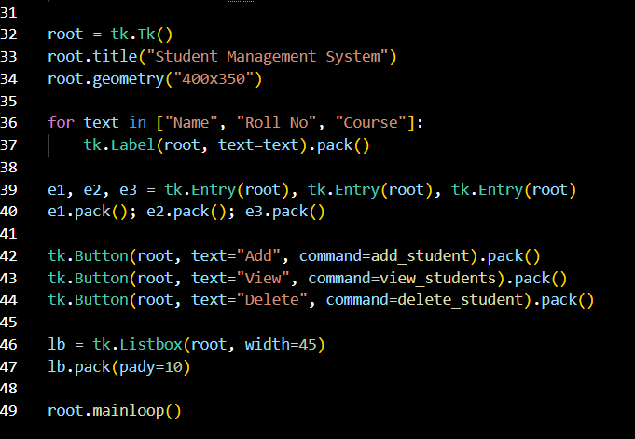

Slide 11
